Slide 1


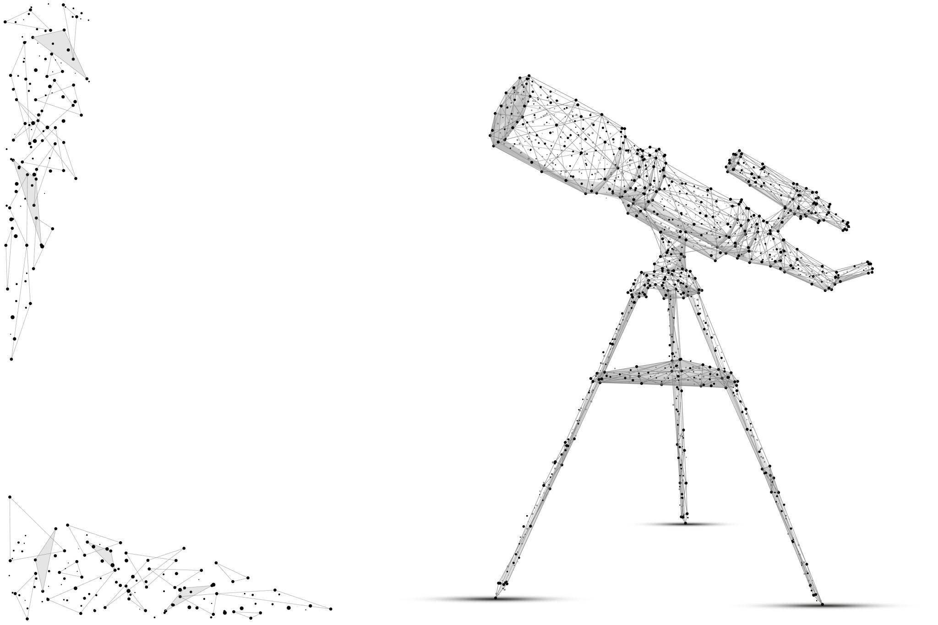
Telescope Scheduling
CSC - 2400
Remek Botwright
Danny English
Soren Richards
Luke Sapp

Slide 2
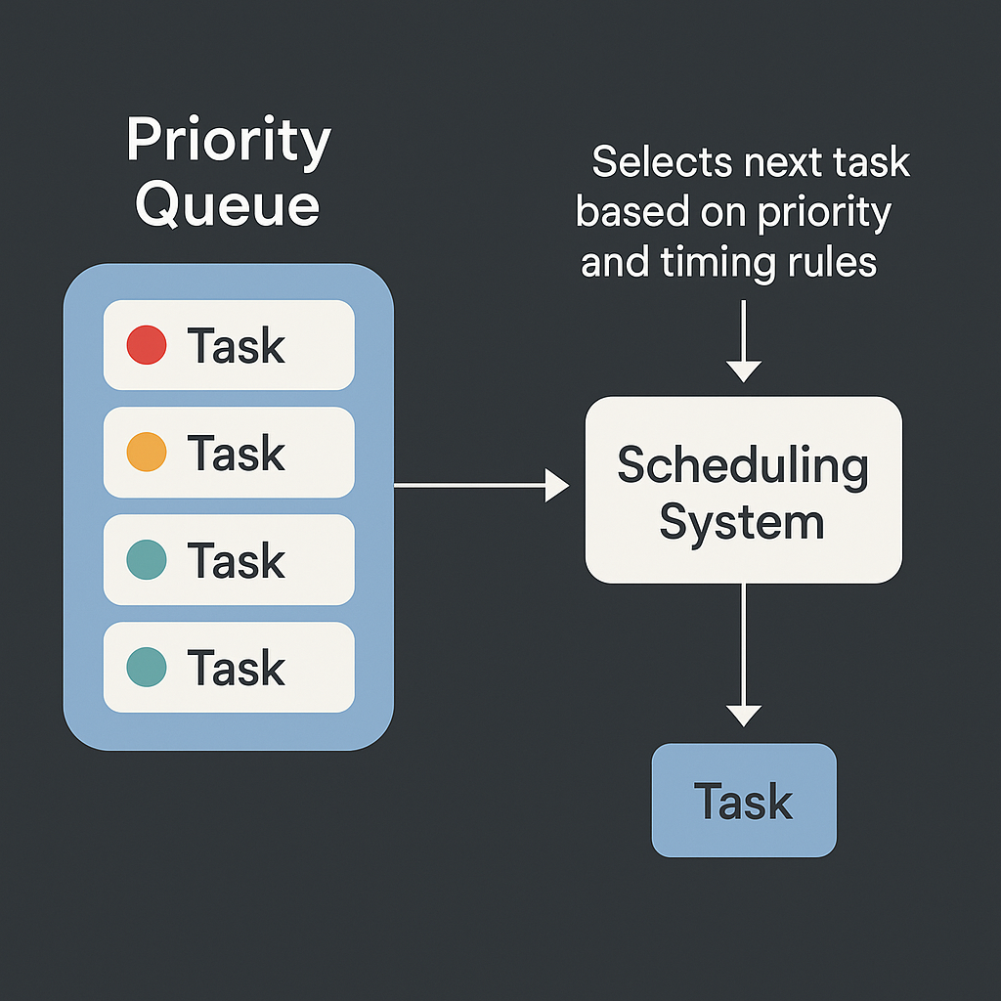
What is Telescope Scheduling?
A System that chooses which task should run next based on a priority queue and timing rules
Ensures high-value tasks get processed while keeping overall idle time low
Continuously updates the queue when conditions change, reshuffling tasks as needed.

Slide 3



Analyze and compare three different Telescope Scheduling algorithms:
Project Overview
Goal
Greedy
Dynamic Scheduling
Ant Colony Optimization

Slide 4

Dataset and testing setup
Generated 1000 datasets of 1000 schedule items with weights using generative AI
Cut down testing to 100 data items due to per item time
Set up a python code to run all schedules through all algorithms, outputting time taken per schedule, as well as outputting the result schedules for each algorithm for the first schedule ran

Slide 5
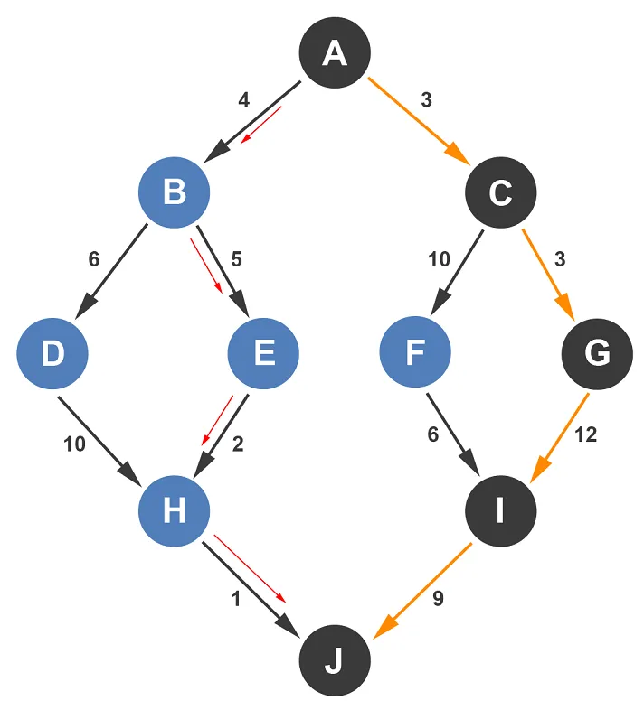
Greedy
Fastest of the 3 algorithms
Time complexity dominated by sorting algorithm speed, so the total algorithm is Θ(n log n)
Simplest of the 3 algorithms

Slide 6
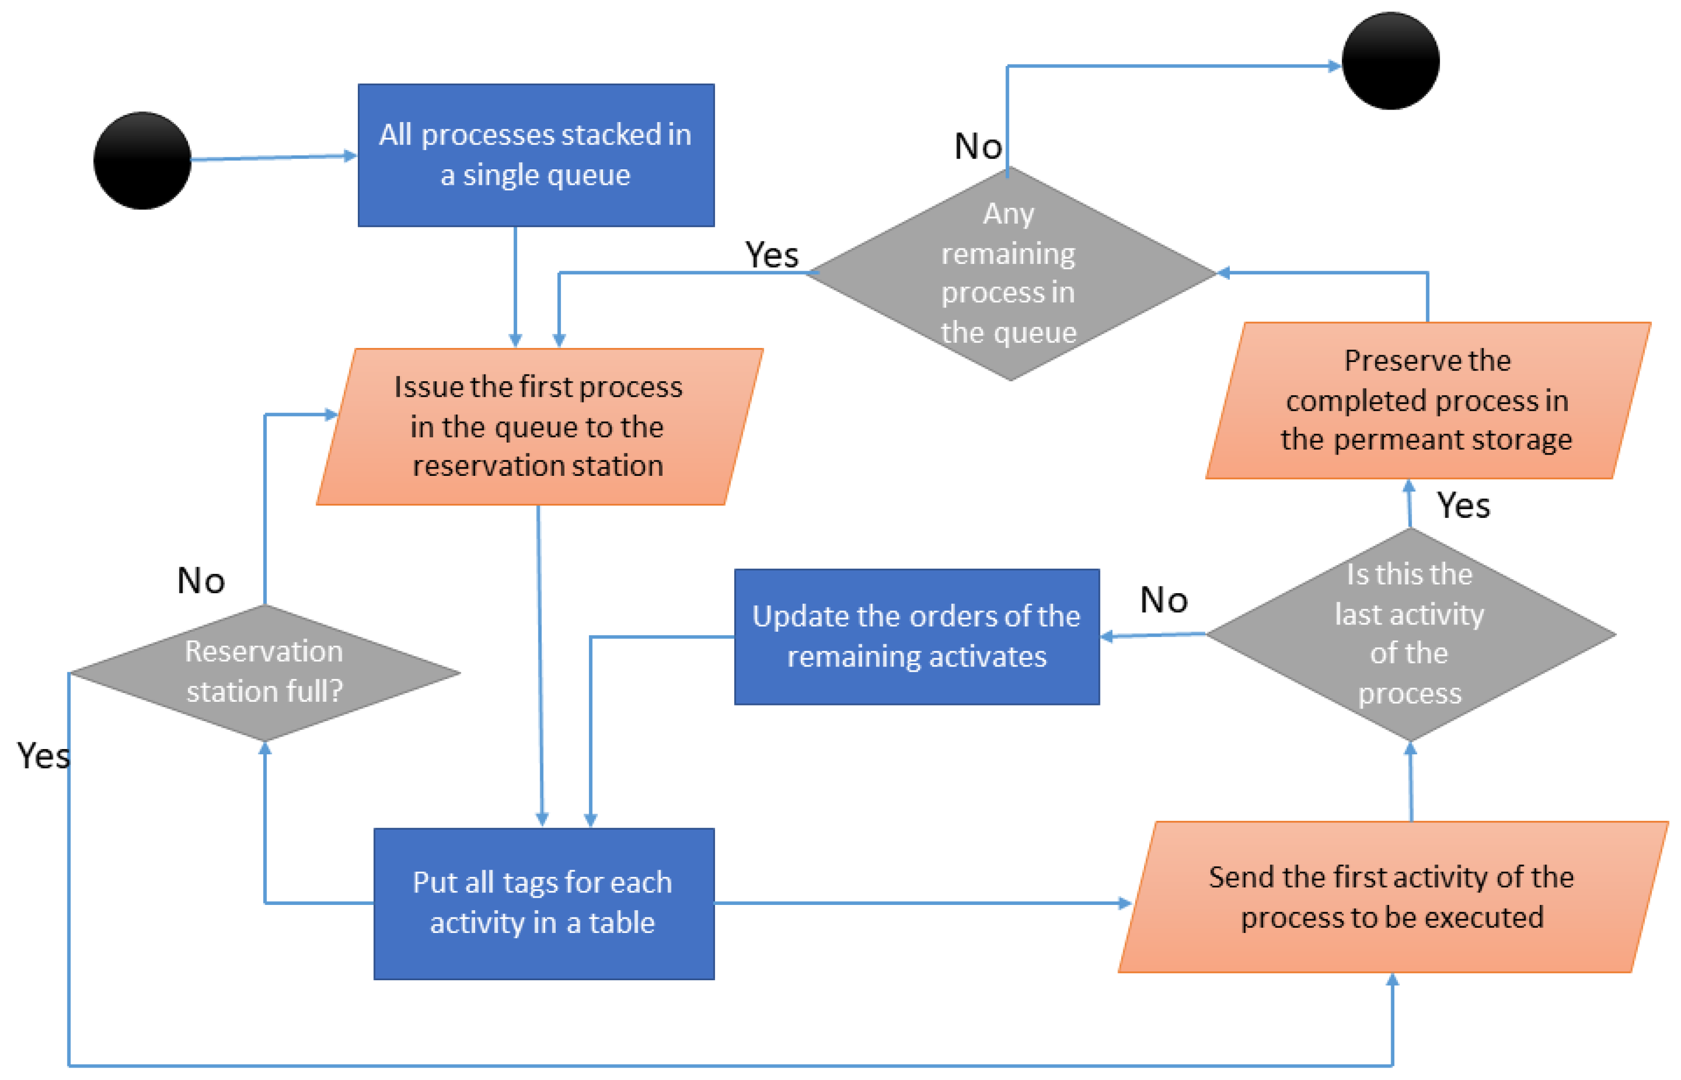
Dynamic Scheduling
Slightly longer than greedy
Unoptimized has a rate of growth of Θ(n²), if pre-processed it could be lowered to Θ(n log n), making it near equal to greedy
Far more complex than greedy, possibly more useful in unweighted schedules

Slide 7
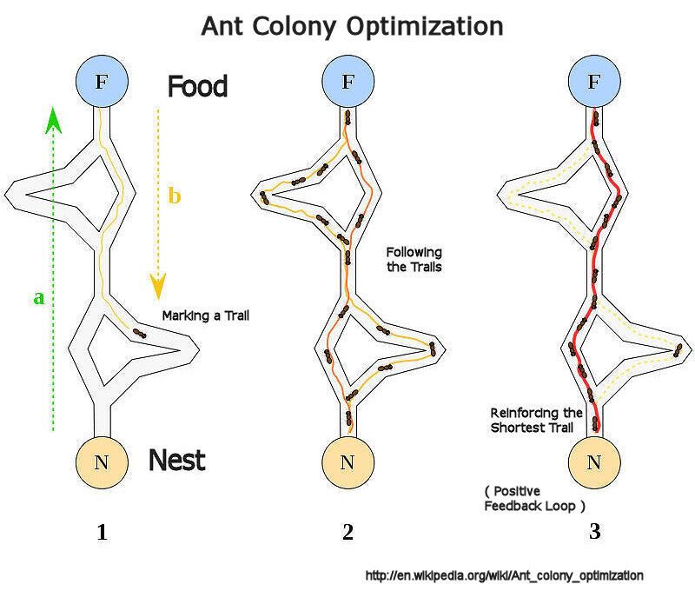
Ant Colony Optimization
Gives varied schedules, so it is good for large singular schedules with large amounts of complexity
Due to our testing methodology, Ant Colony Optimization (ACO) started at a disadvantage
Ant colony is Θ(I · m · n), with I being the number of iterations, and m being the number of ants

Slide 8
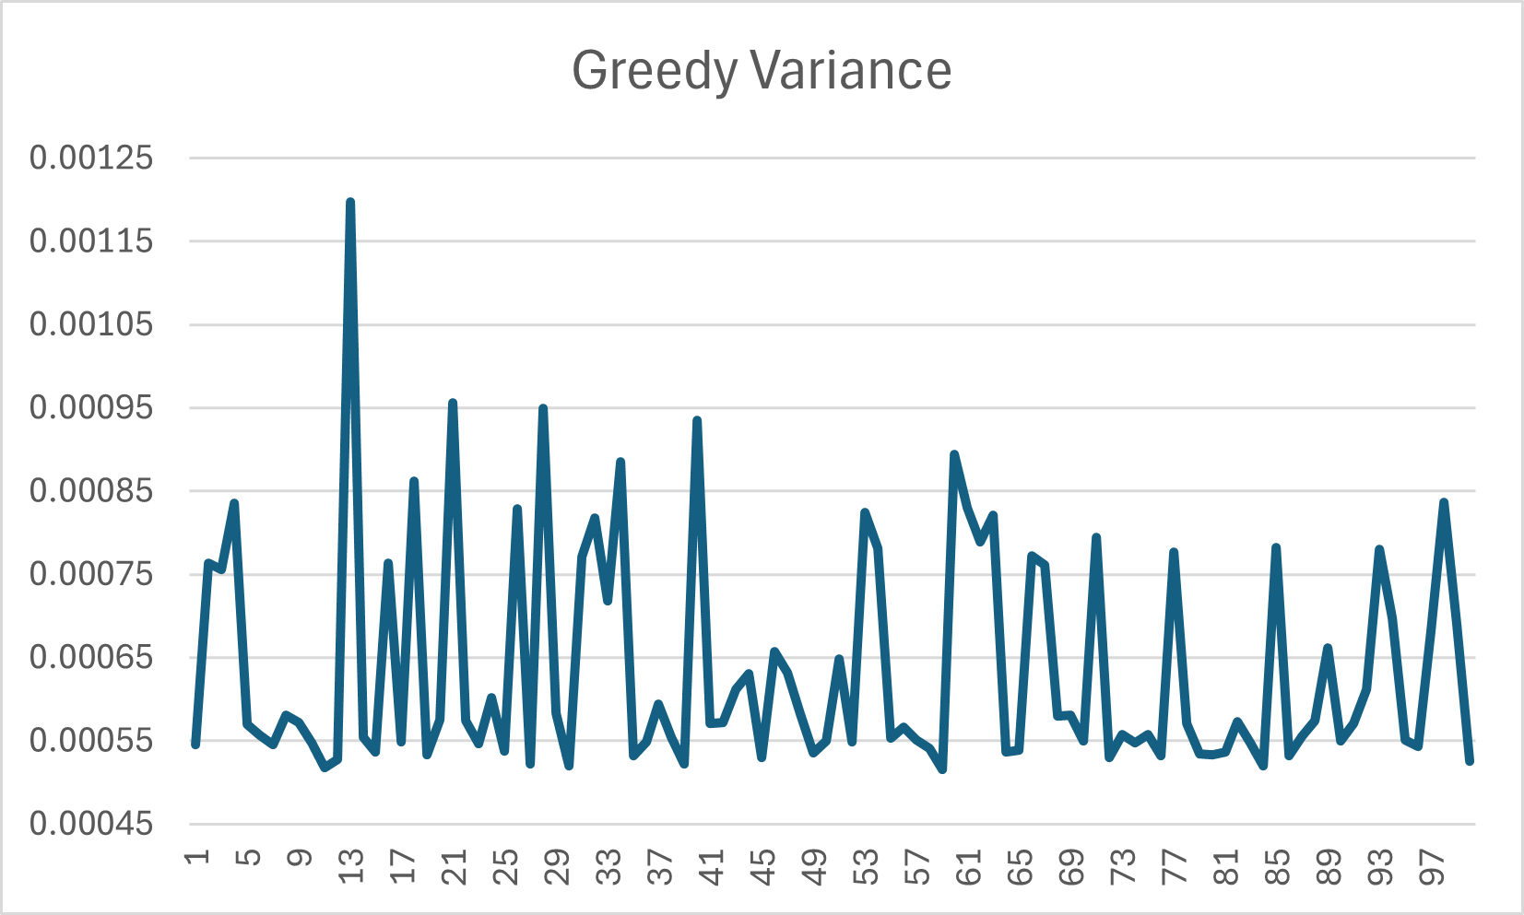
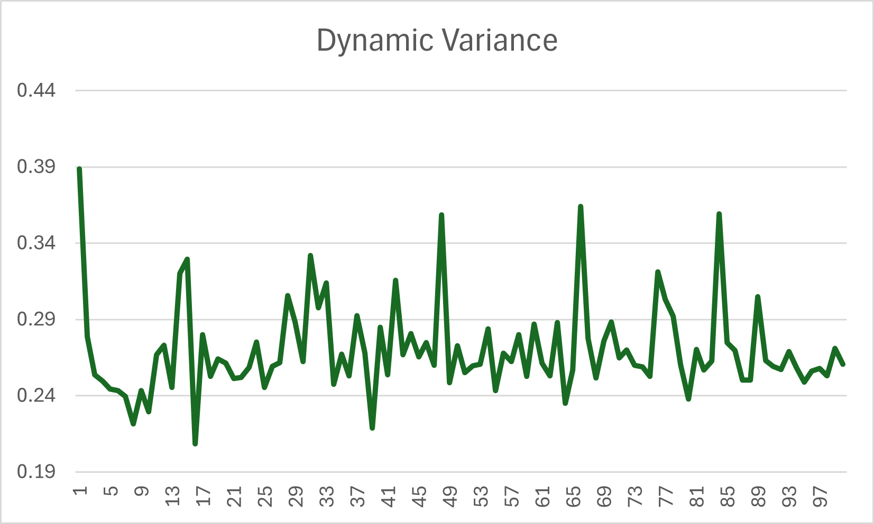
Variance Comparison

Slide 9
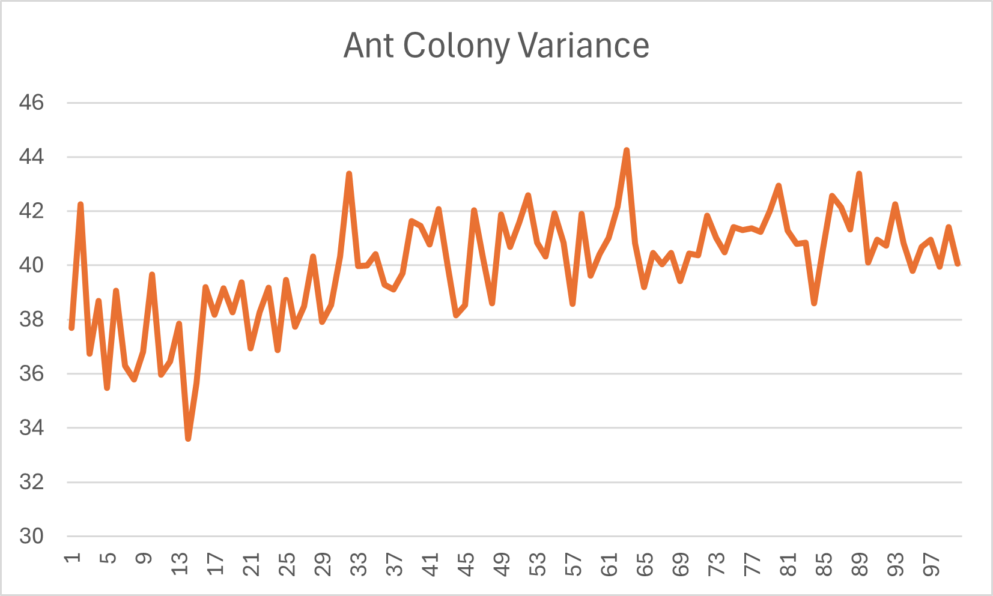
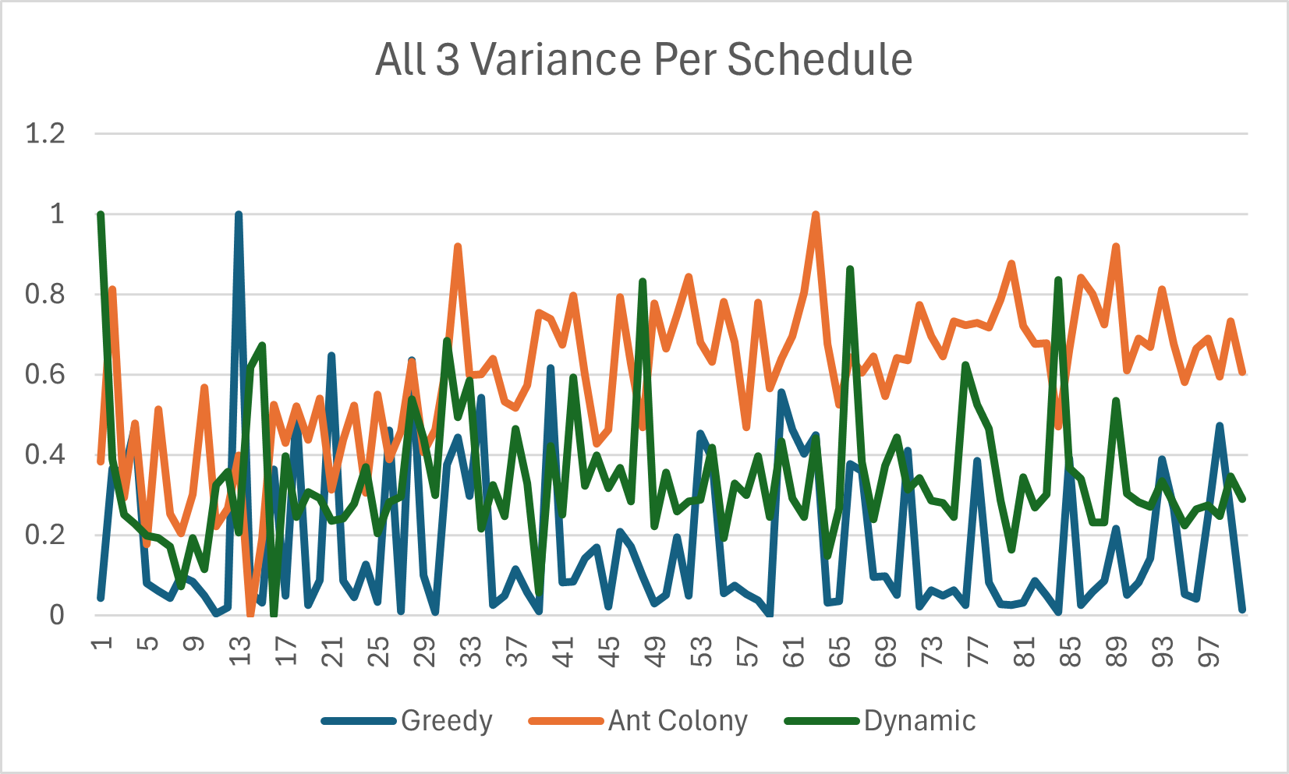
Variance Comparison

Slide 10

Schedule Quality Comparison
Greedy and Dynamic produced nearly identical schedules across all weighted datasets.
Both algorithms prioritized higher-weight tasks consistently, resulting in stable and predictable outputs.
Ant Colony Optimization generated noticeably different schedules due to its probabilistic search process and smaller ant count.
ACO’s reduced ant population led to less optimal solutions, especially on larger datasets.
Overall, Greedy and Dynamic delivered more consistent and dependable schedule quality, while ACO showed more variation with both strengths and gaps depending on parameters.

Slide 11
Final Summary
Greedy and Dynamic algorithms consistently produced accurate and reliable schedules across large, weighted datasets
Greedy proved to be the most practical option due to its extremely fast runtime and strong scalability.
Dynamic offered similar output quality but required more time, making it effective but less efficient for large-scale testing.
Ant Colony Optimization generated more varied results but became significantly slower as dataset size and ant count increased.
ACO may be better suited for smaller or specialized scheduling problems where longer computation times are acceptable.
Overall, for large real-world scheduling scenarios that prioritize speed and consistency, Greedy is the most effective choice, with Dynamic as a strong secondary option.

Slide 12
Questions?

